Slide 1
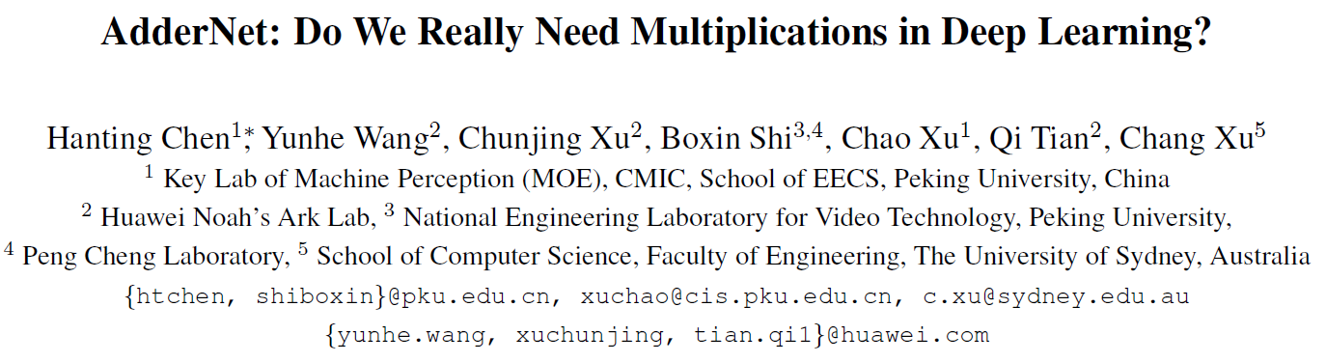

Slide 2
Why AdderNet
Compared with cheap addition operation, multiplication operation is of much higher computation complexity.

Slide 3
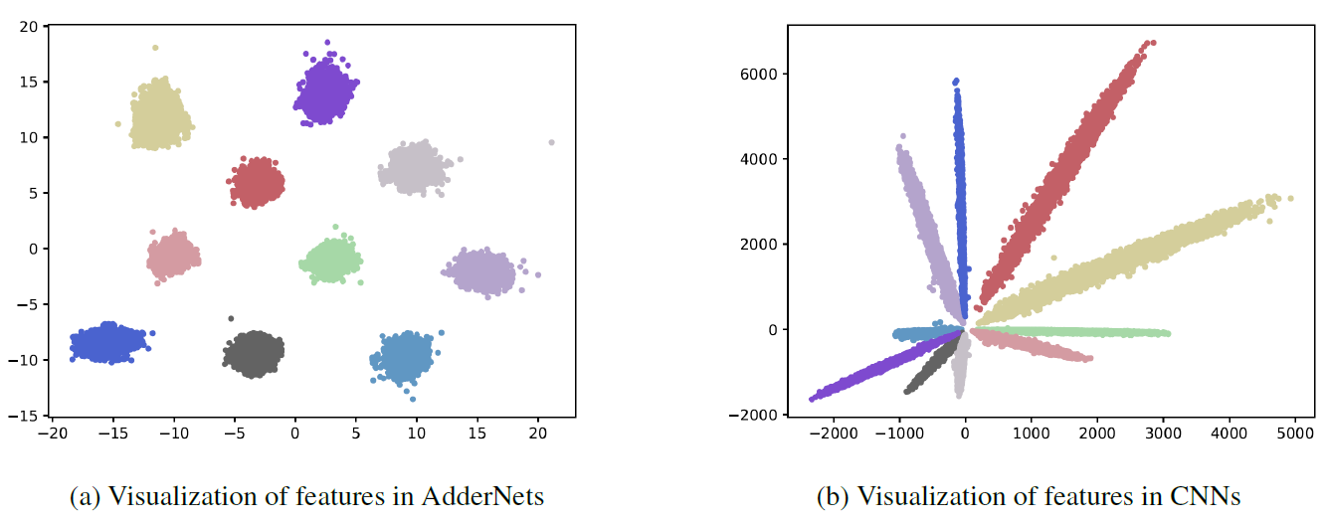
The difference between CNN and AdderNet
CNN : cross-correlation to measure the similarity between input feature and convolution filters, which involves massive multiplications between float values.
AdderNet: use the L1-norm distance between filters and input feature as the output response.

Slide 4

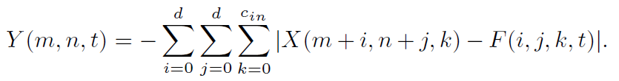
The detail of AdderNet (1)
CNN
AdderNet

Slide 5
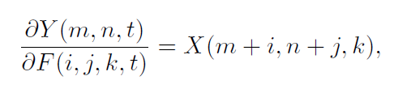
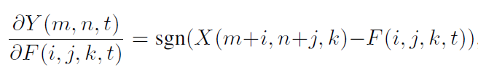


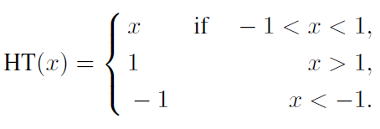
The detail of AdderNet (2)
CNN
AdderNet
SgnGrad
FullPrecisionGrad

Slide 6
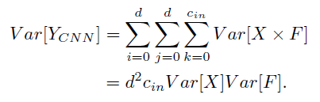
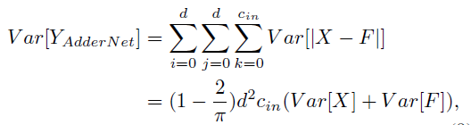
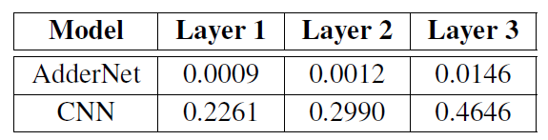



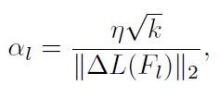
The detail of AdderNet (3)

Slide 7
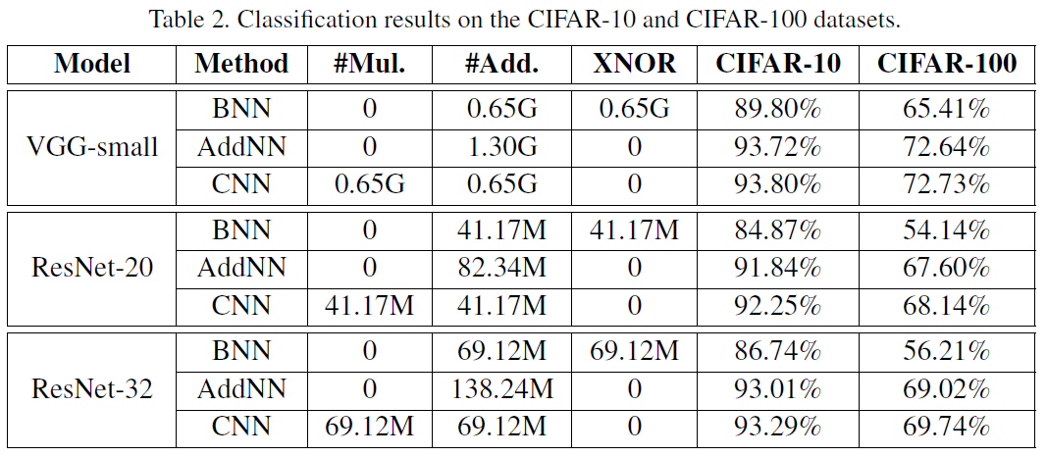
Experiments(1)

Slide 8
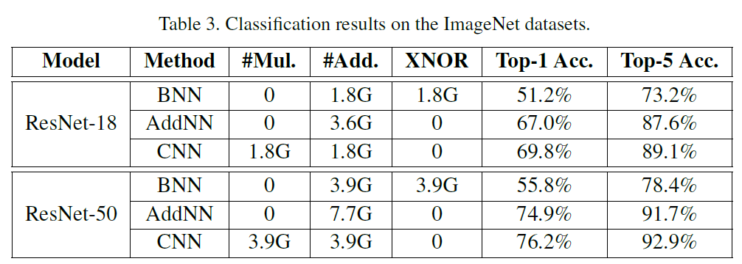
Experiments(2)

Slide 9
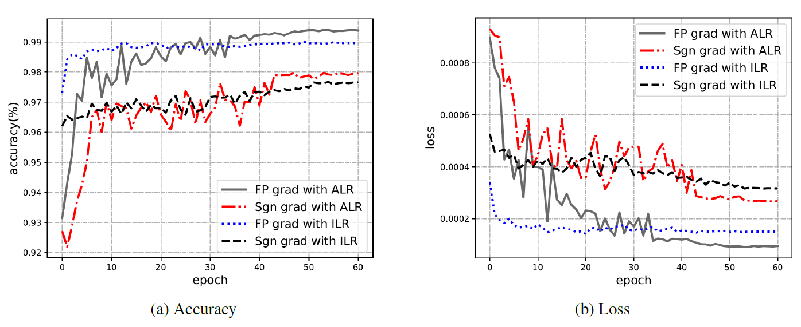
Experiments(3)

